Slide 1

Term Project
Justin Wisniewski

Slide 2
Statistical Questions / Hypothesis
Why do employees want to leave?
Why do they want to stay?
How can we make them motivated?

Slide 3
Variables
Age and Gender
Business Travel
Department
Daily Rate
Distance From Home
Education (Ranked 1-5, 1 being below college, 5 being doctorate)
Work Life Balance (Ranked 1-4, 1 being the worst, 4 being the best)
Years @ Company
Years with Current Manager

Slide 4
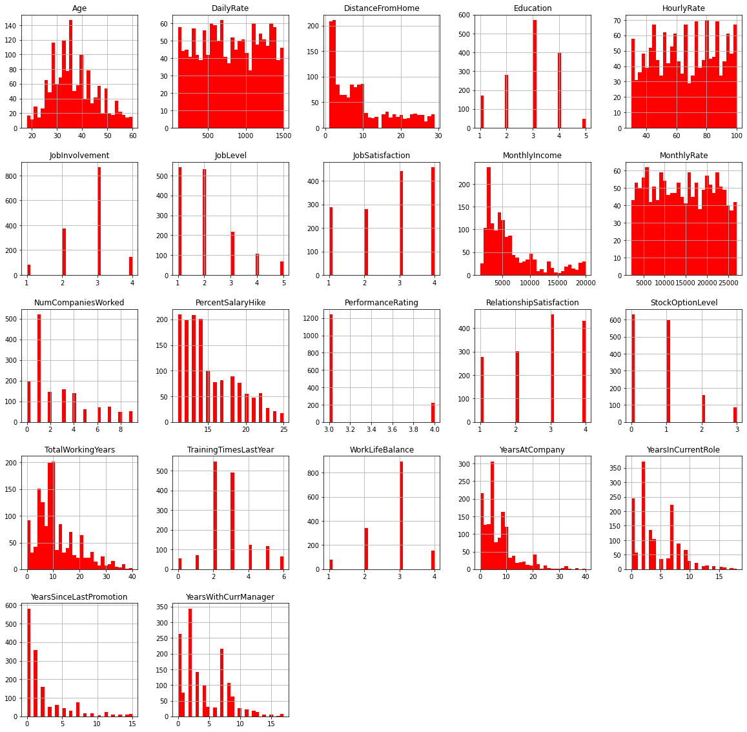
Histograms

Slide 5
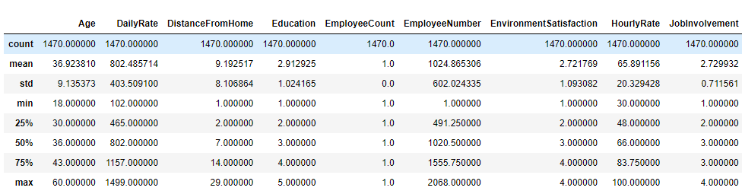
Descriptive Characteristics for Variables (additional variables included within code)

Slide 6
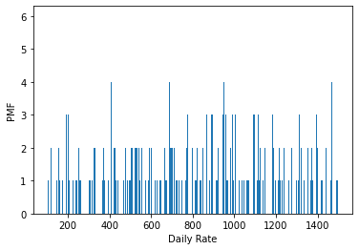
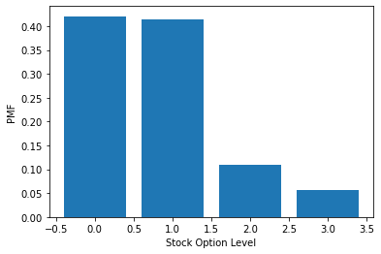
Daily Rate & Stock Option PMF

Slide 7
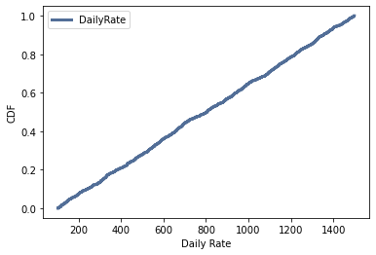
CDF

Slide 8
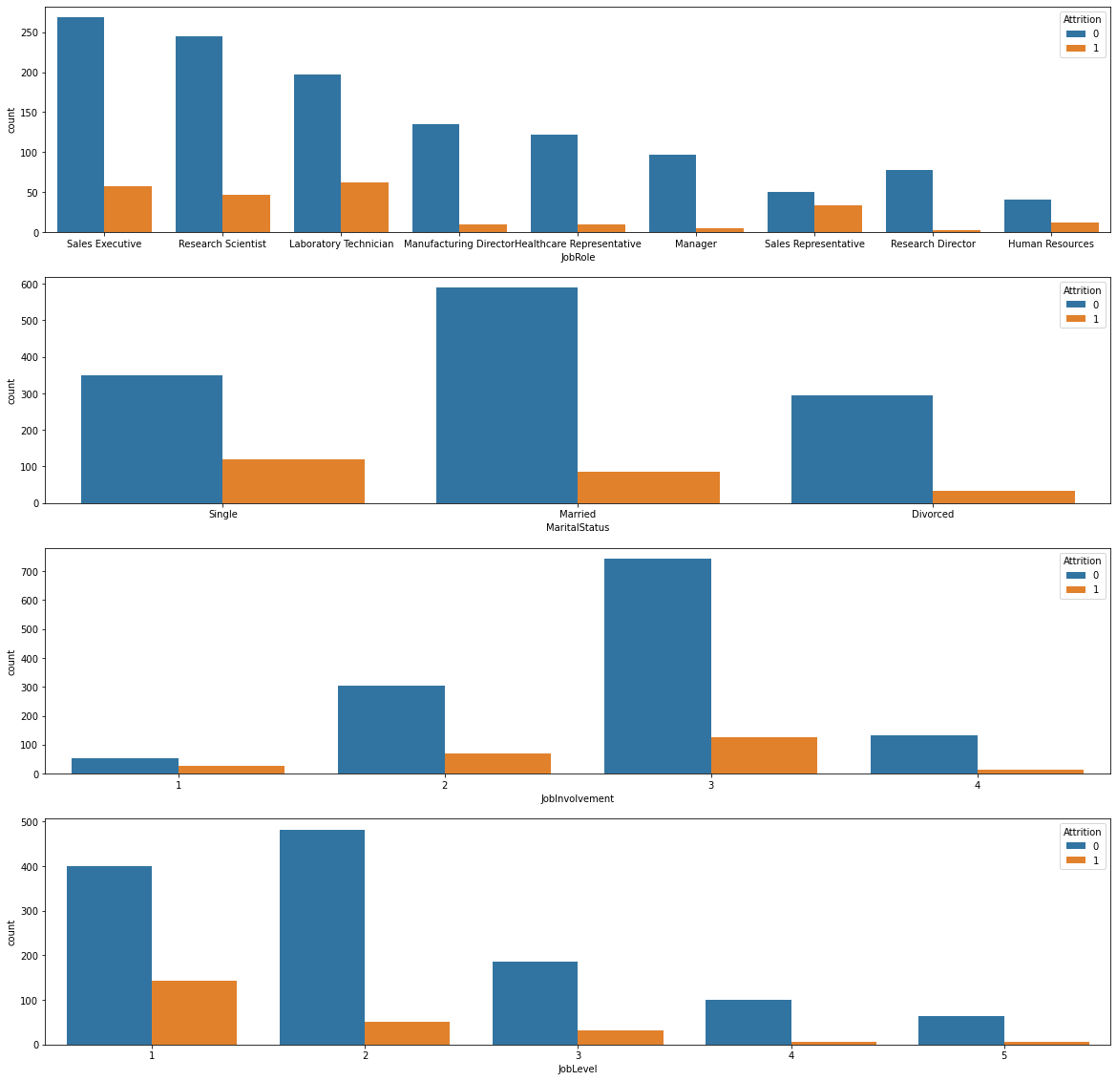
Plots
# Single employees tend to leave compared to married and divorced
# Sales Representatives tend to leave compared to any other job
# Less involved employees tend to leave the company
# Less experienced (low job level) tend to leave the company

Slide 9
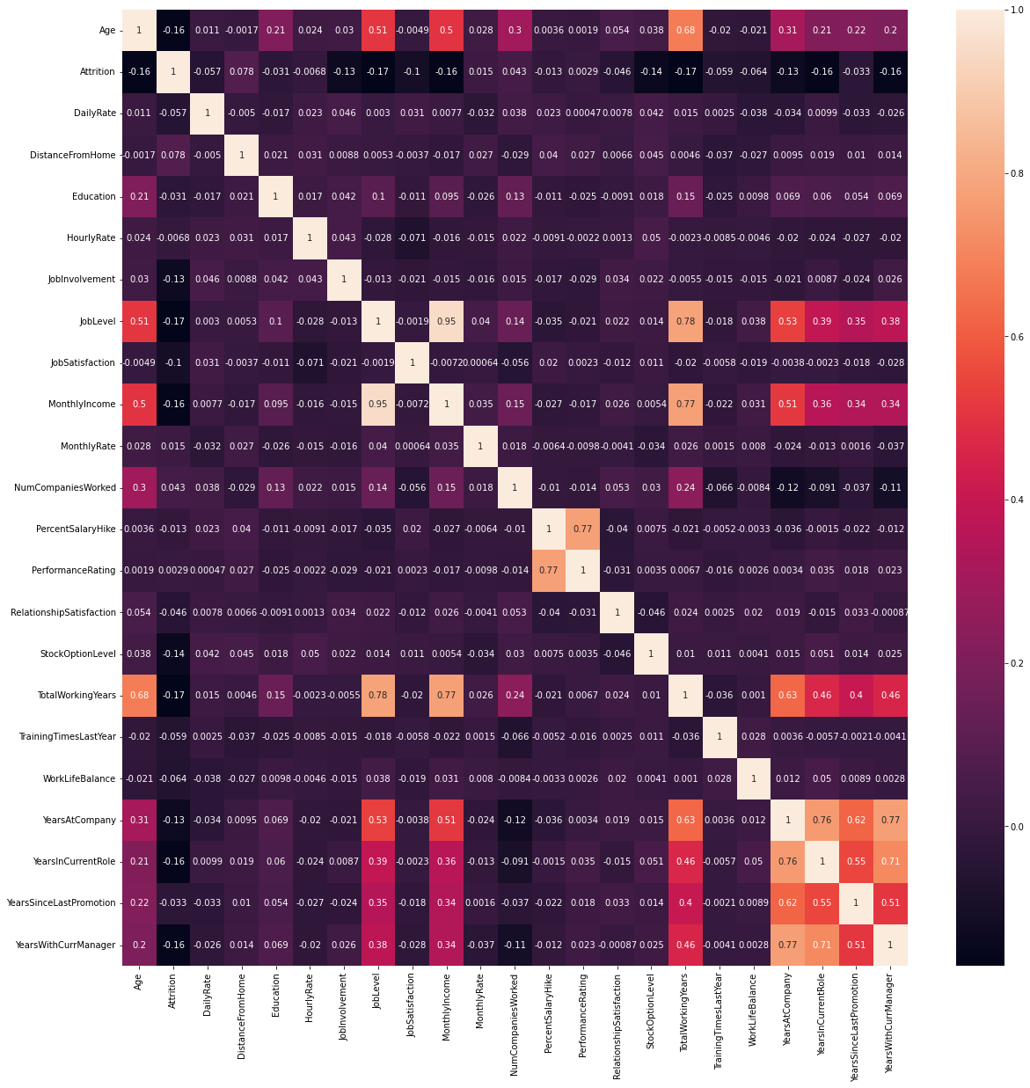
Correlation
# Job level is strongly correlated with total working hours
# Monthly income is strongly correlated with Job level
# Monthly income is strongly correlated with total working hours
# Age is strongly correlated with monthly income

Slide 10
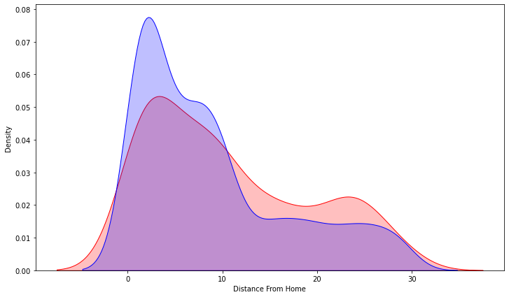
KDE (Kernel Density Estimate)
Red represents the employees who left. As we can see, the further distance from home the more likely it is for an employee to leave.

